Slide 1


Reusable Silicone Bagging
- Reduce Non Compliant Aerospace Parts
Notes:
Introduction – Traditional method of using vacuum bagging film has been

Slide 2
Overview
Reusable Silicone Bagging vs. Bagging Film
  Cost Reduction Analysis
  Silicone Bagging allows for improved Quality Awareness
Managing Silicone Contamination
  Controlled Contamination Area
  Two Types of Silicone contamination
Silicone Technology on the Horizon
  V-Groove Sealing
  Out of Autoclave Processes

Slide 3
Silicone Bagging vs. Film
 | SILICONE | FILM
Reusable after Autoclave/Oven Cure | Yes | No
Net Shape | Yes | No
Post Finishing Requirements | No | Possible
Bridging | No | Yes
Bag Placement Skill Level | No Specialized Training Required | Specialized Training Required
Fabrication Time | 2 minutes/ sqft | None
Bag Placement Time | Minutes | Hours
Notes:
No Bridging eliminates need for using intensifiers
Bag Placement Skill is more of an art form. Most people that have the skill set will be retiring soon.

Slide 4
Silicone Bagging Cost Reduction
Consumable Waste Minimization
  Single Use Bagging Film
  Bagging Tape
  Disposable Waste Fees

Slide 5
Silicone Bagging Cost Reduction
Labor Reduction in Part Preparation
  Quicker Bag placement and leak checks
  Net Shape Bag = No Pleats to Manage
Labor Reduction in Finished Part Preparation
  Net Shape Bag = Greater Corner Compaction
Labor savings in Non-Complaint Part Repair
  Time is eliminated for Repair Approval Process
47% Labor savings using Reusable Silicone Bagging
47% LABOR SAVINGS
Notes:
New ISO standards are in place requiring the environmental footprint to be minimal.

Slide 6
Cost Analysis of Materials

Slide 7
Cost Analysis of Materials/Labor
Notes:
Based on $50/hr labor rate. 1 hour for silicone bag fabrication, 3-5 min, bag placement. 1 hour for each placement of film for each cycle. Does not include non-compliant cost

Slide 8
Quality Awareness Revolution
Traditional Bagging Film Method
  Limited ability to verify if material lay up was correctly placed prior to autoclave/oven
  Average reject rate 7%
  Rejects (Non-Complaint Parts) were attributed to the fault of Lay-Up Personal
Tooling
Lay-Up
Autoclave
Post-Inspection
Compliant Part
Non-Compliant Part
Additional Labor Repair
Or Reject
Post Repair

Slide 9
Quality Awareness Revolution
Net Shape Reusable Silicone Bagging
  Instant Visual Feedback with layup. Corrections made before autoclave/ovencure
  0% In Non-Compliant Parts
  Tooling Department being revamped for Quality Awareness
Tooling
Lay-Up
Autoclave
Post-Inspection
Compliant Part
Non-Compliant Part
Additional Labor Repair
Or Reject
Post Repair

Slide 10
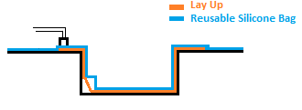
Net Shape Silicone Bagging
Spray Fabricated to quickly conform to the precise shape of intended part
Bag will not properly fit when lay-up is incorrectly placed
vacuum
Instant Visual Feedback
Incorrect Lay-Up
Instant Visual Feedback
Correct Lay-Up

Slide 11
Managing Silicone Contamination
Controlled Contamination Area – CCA
Silicone Contamination
  Uncured – Liquid State
    Direct Contact
  Room Temp Cure – (Pre-Post) Cure Process
    Post Cure Bag Required
Notes:
Nadcap - CCA
Contract Bag Manufacturers

Slide 12
Silicone Bagging on the Horizon
Methods of Sealing a Silicone Bag
  Clamping Frame
  Modification of Bag
    Utilizing Tacky Tape
    Utilizing Tacky Tape in Conjunction with bonding substrate with Silicone
  Modification of Tool
    V-Groove Sealing Technology

Slide 13

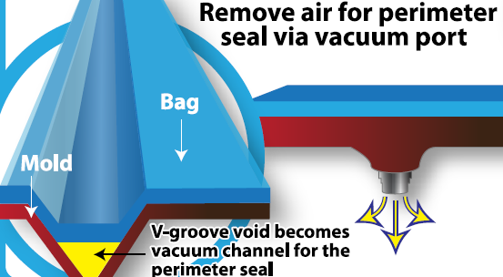
Silicone Bagging on the Horizon
V-Groove Sealing
  Preferred method of sealing silicone bagging

Slide 14
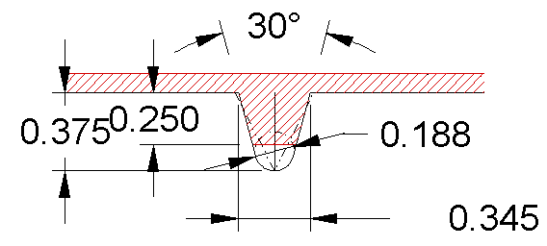
V-Groove
Can be implemented in limited flange depth
Minimize tool footprint in autoclave/oven
Notes:
3/8 in deep truncated V. Can accommodate 1/2in deep flange.

Slide 15
Silicone Bagging Applications on the Horizon
Out of Autoclave Process
Infrared Technology
Notes:
OOA – Spray fabricated on uncured part structure

